Slide 1

Neuroinformatics Lecture (L5)
Improve Slides
L5_Part_2_Applied_Graphical_Net
Slides: 2 – 18
Fabian Imkenberg,
Jacqueline Näther,
Christoph Werries
Prof. Dr. Gordon Pipa
Institute of Cognitive Science, University of Osnabrück
Notes:
Hallo and thank you for the introduction.
I will present a non-parametric significance test for estimating the statistical significance of Joint-Spike events.

Slide 2
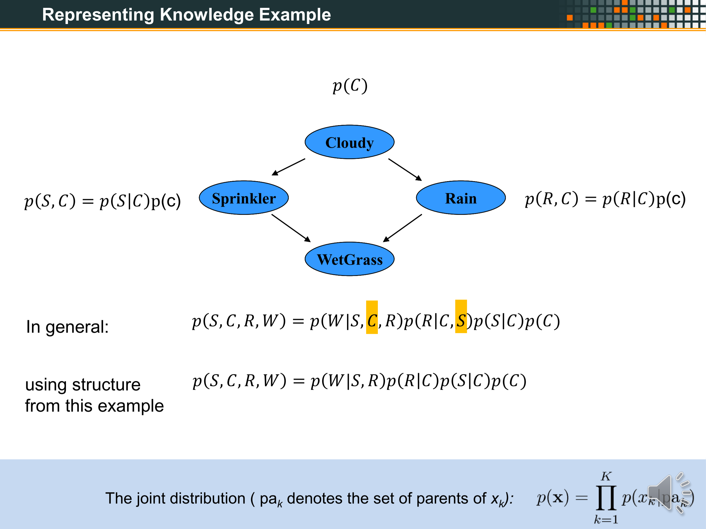
XXX
XXX
OLD

Slide 3
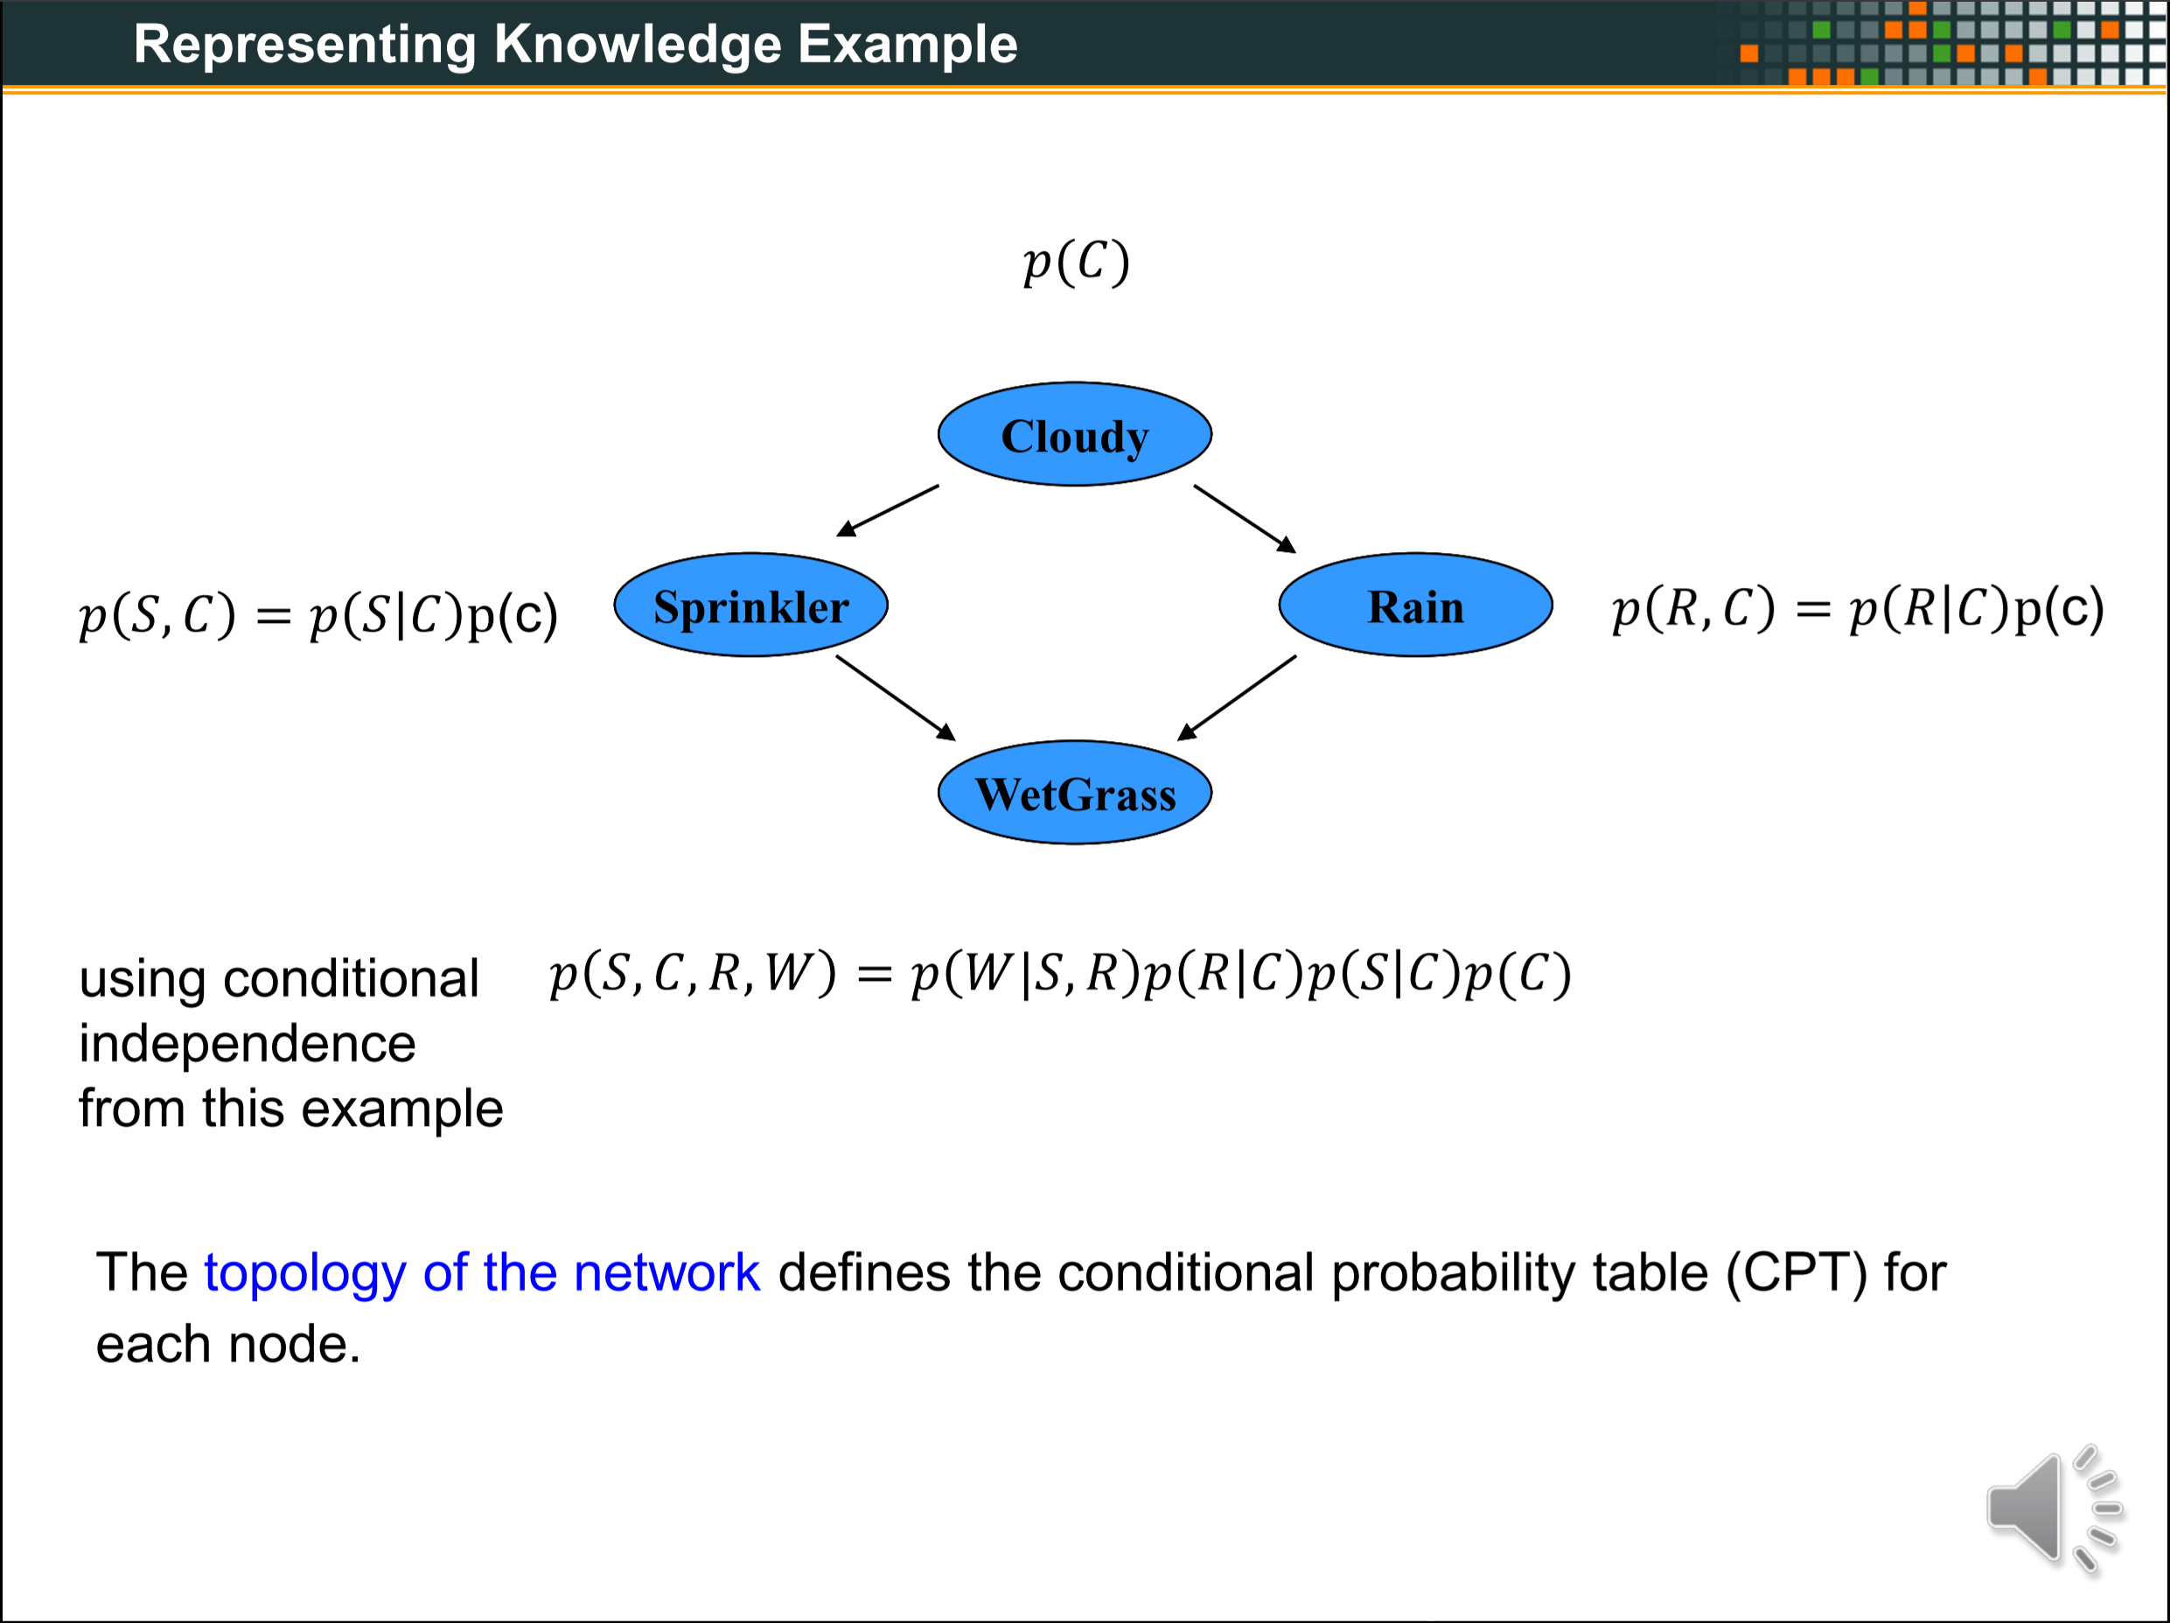
XXX
XXX
OLD

Slide 4
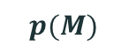
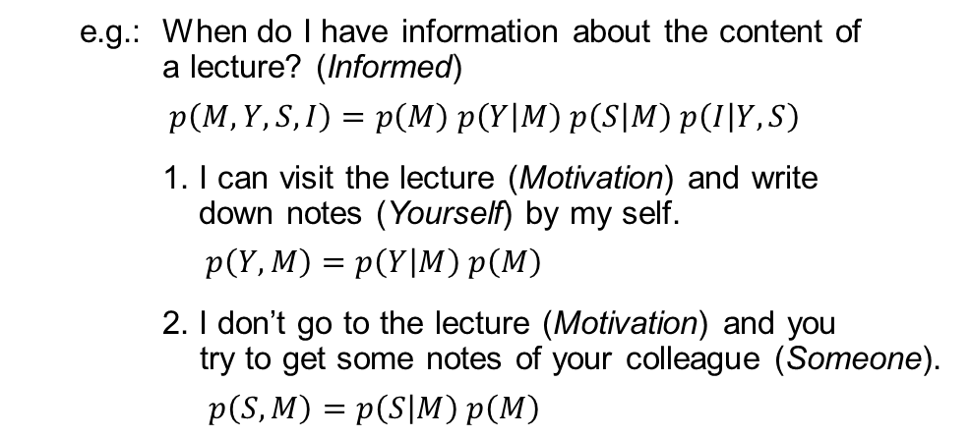
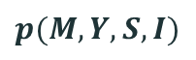
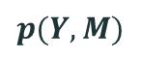
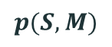
Representing Knowledge Example
How to use graphical models for real world problems?
The model can help us to understand how a special state is dependent on its conditions.
e.g.: When do I have information about the content of
a lecture? (Informed)
$p\left(M, Y, S, I\right)=p\left(M\right) p\left(Y | M\right) p\left(S | M\right) p\left(I | Y,S\right)$
1. I can visit the lecture (Motivation) and write
down notes (Yourself) by my self.
$p\left(Y,M\right)=p\left(Y | M\right) p\left(M\right)$
2. I don’t go to the lecture (Motivation) and you
try to get some notes of your colleague (Someone).
$p\left(S,M\right)=p\left(S | M\right) p\left(M\right)$
$$p(M)$$
Motivation
$$p(Y, M)$$
$$p(S, M)$$
Yourself
Someone
Informed
$$p(M, Y, S,I)$$
With knowing the probabilities, there is a way to easily represent the topology of the network, using concrete numbers of the probabilities.
➔ using Conditional Probability Tables (CPT)

Slide 5
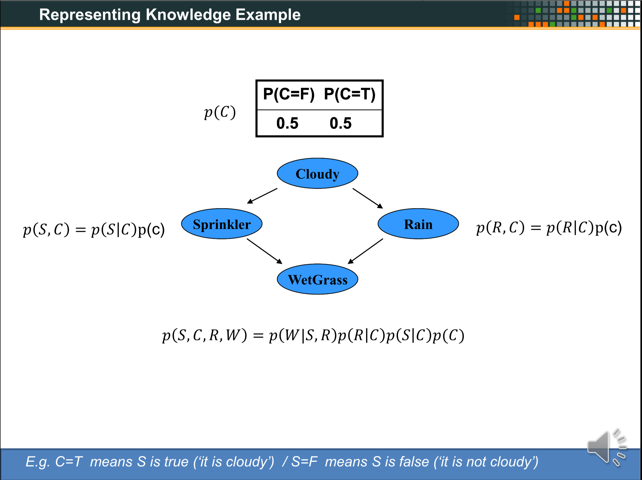
XXX
XXX
OLD

Slide 6
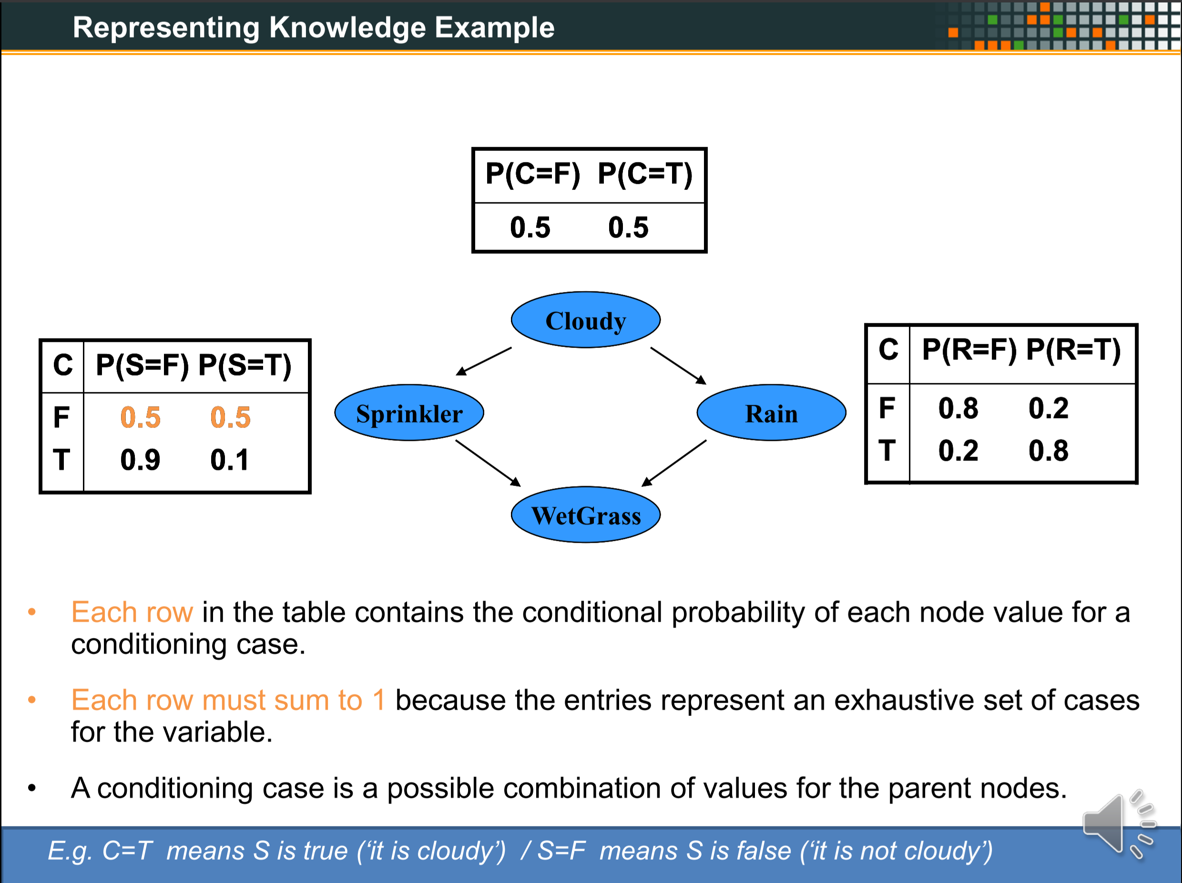
XXX
XXX
OLD

Slide 7
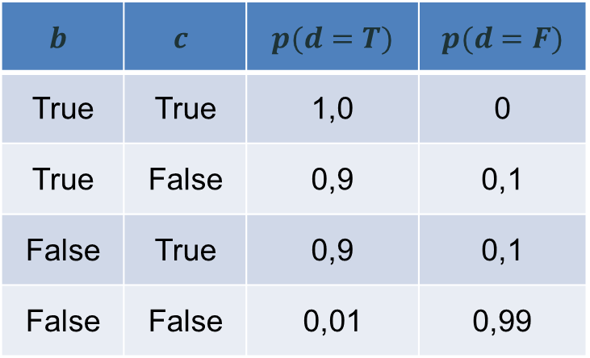
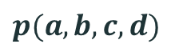
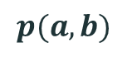
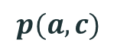
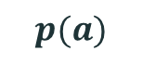
Representing Knowledge Example
How does it work with CPTs?
$$p(a)$$
a
$$p(a,b)$$
$$p(a,c)$$
Conditions which are linked to the node you are looking at.
b
c
Probabilities of each case form the node you are looking at.
d
$$p(a,b,c,d)$$
$$b$$ | $$c$$ | $$p(d=T)$$ | $$p(d=F)$$
True | True | 1,0 | 0
True | False | 0,9 | 0,1
False | True | 0,9 | 0,1
False | False | 0,01 | 0,99
Area which is represented by the table.
Probabilities of the node you are looking on (here d).
These one are given.
! The sum of the probabilities of condition cases must be 1.
Condition cases of the conditions which are linked to the node you are looking at.

Slide 8
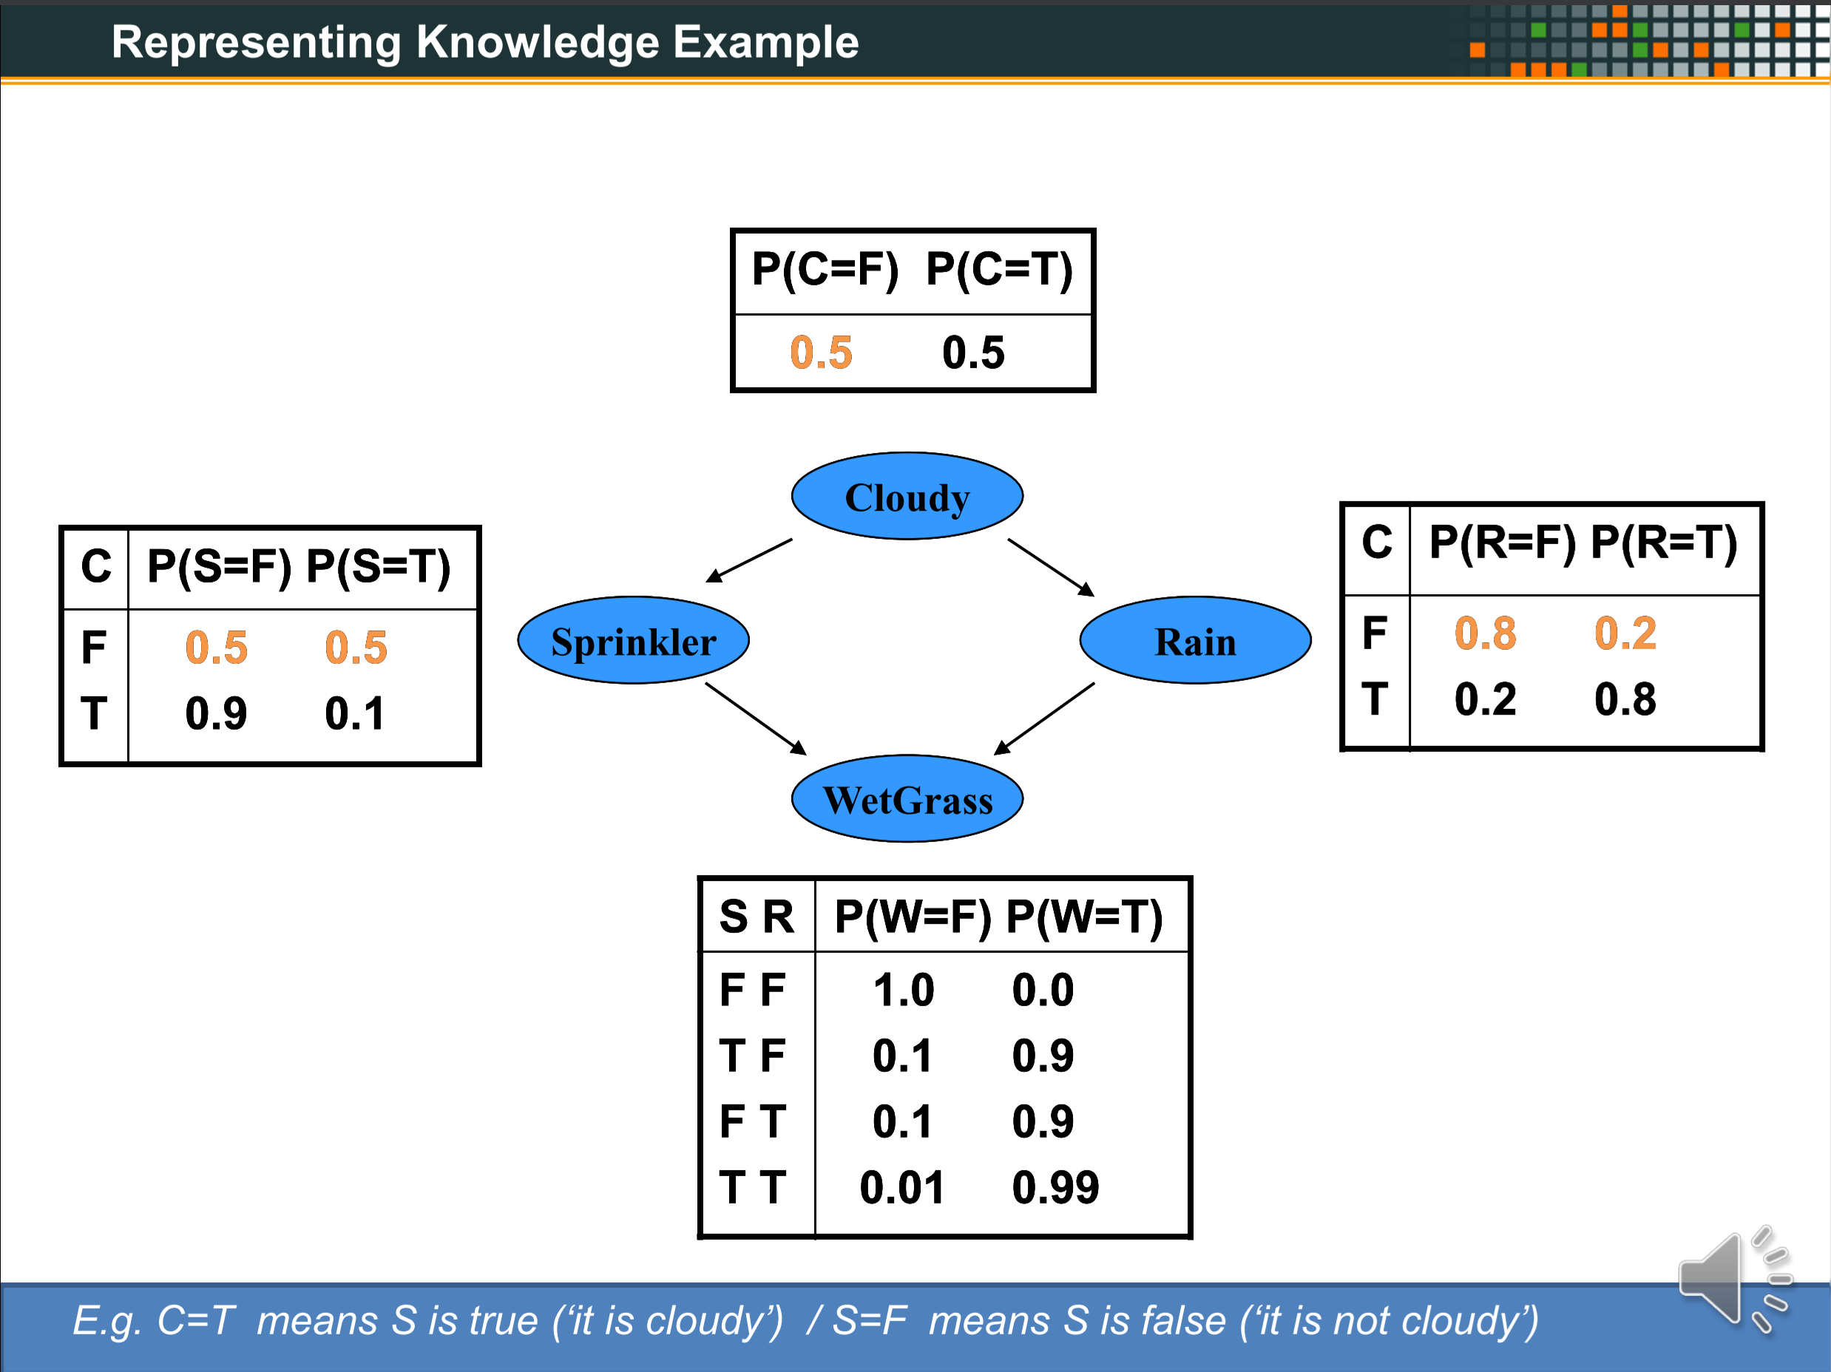
XXX
XXX
OLD

Slide 9
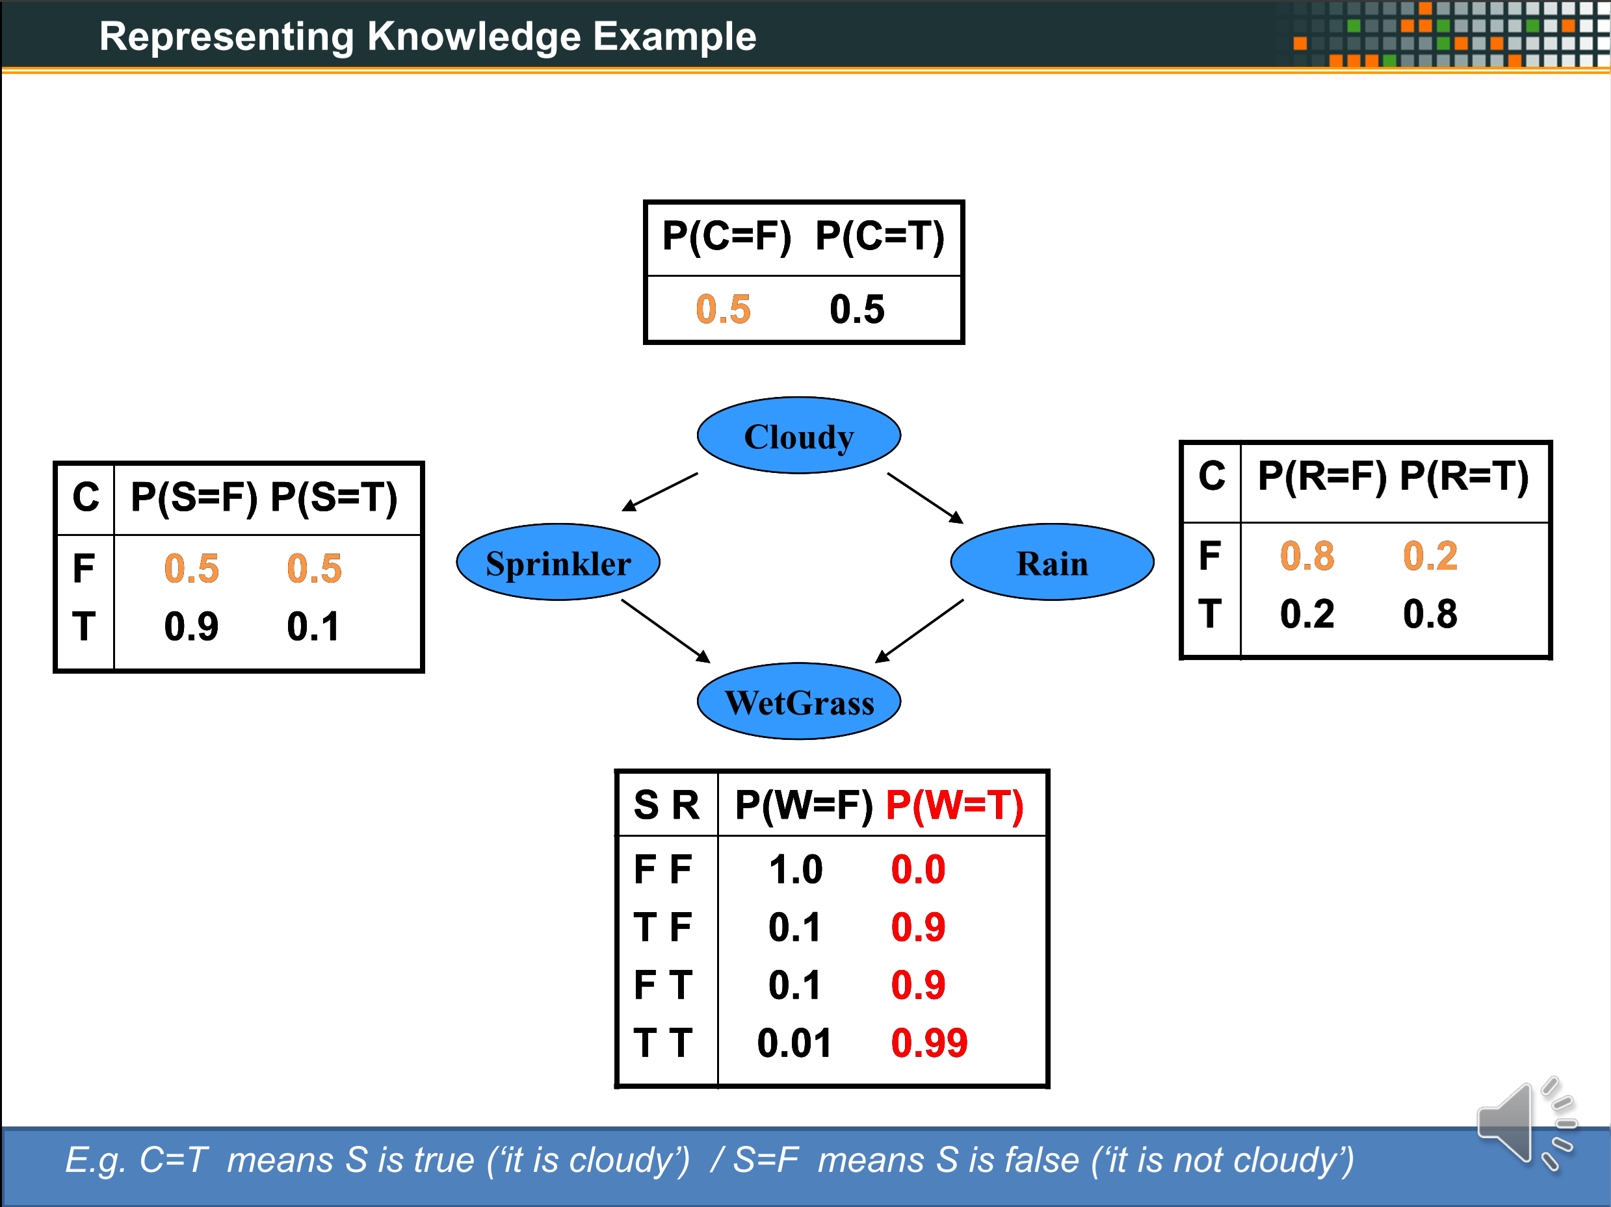
XXX
XXX
OLD

Slide 10
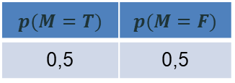
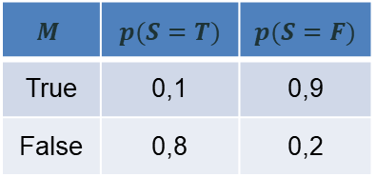
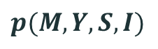
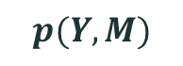
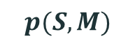
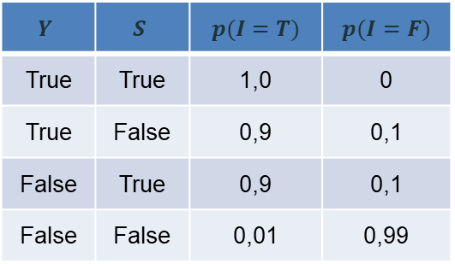
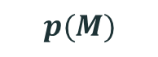
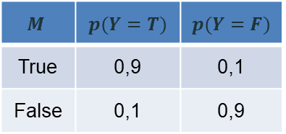
Representing Knowledge Example
Example: CPTs using for real world problems.
$$p(M=T)$$ | $$p(M=F)$$
0,5 | 0,5
$$p(M)$$
Motivation
$$M$$ | $$p(Y=T)$$ | $$p(Y=F)$$
True | 0,9 | 0,1
False | 0,1 | 0,9
$$p(Y,M)$$
$$p(S, M)$$
$$M$$ | $$p(S=T)$$ | $$p(S=F)$$
True | 0,1 | 0,9
False | 0,8 | 0,2
Yourself
Someone
Informed
$$p(M,Y,S,I)$$
$$Y$$ | $$S$$ | $$p(I=T)$$ | $$p(I=F)$$
True | True | 1,0 | 0
True | False | 0,9 | 0,1
False | True | 0,9 | 0,1
False | False | 0,01 | 0,99

Slide 11
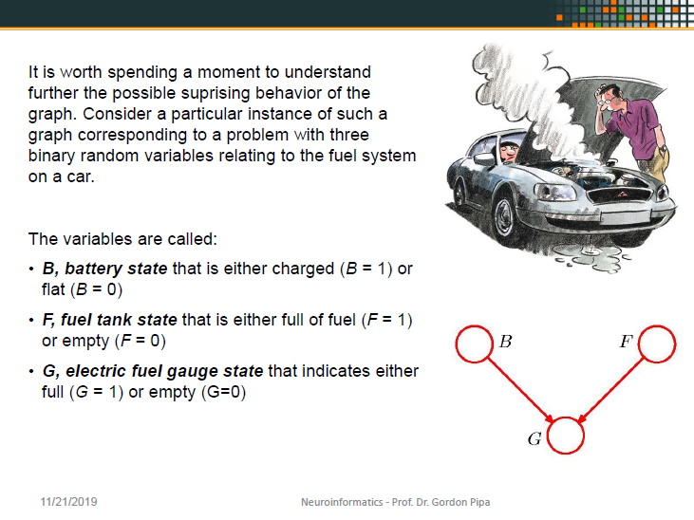
OLD

Slide 12

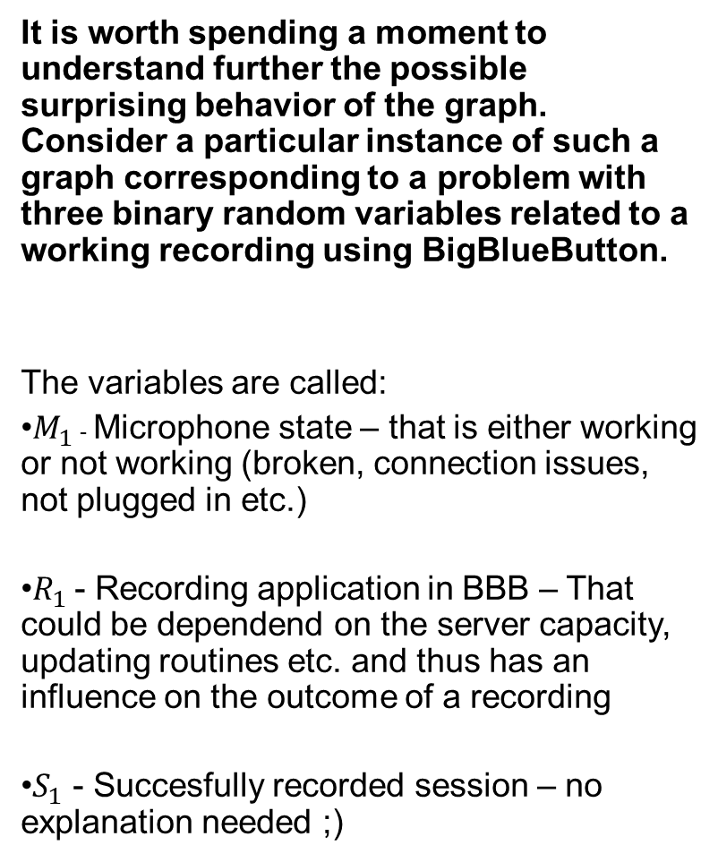
It is worth spending a moment to understand further the possible surprising behavior of the graph. Consider a particular instance of such a graph corresponding to a problem with three binary random variables related to a working recording using BigBlueButton.
The variables are called:
$M_{1}$ - Microphone state – that is either working or not working (broken, connection issues, not plugged in etc.)
$R_{1}$ - Recording application in BBB – That could be dependend on the server capacity, updating routines etc. and thus has an influence on the outcome of a recording
$S_{1}$ - Succesfully recorded session – no explanation needed ;)
M
R
S

Slide 13
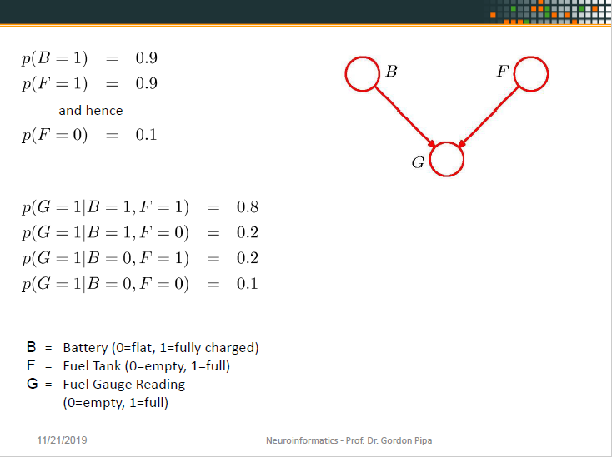
OLD

Slide 14
P(M=1)=0,9
P(M=0)=0,1
P(R=1)=0,9
P(R=0)=0,1
M
R
P(R=1) | P(R=0)
0,9 | 0,1
P(M=1) | P(M=0)
0,9 | 0,1
S
M | R | P(S=1) | P(S=0)
0 | 0 | 0,1 | 0,9
1 | 0 | 0,2 | 0,8
0 | 1 | 0,2 | 0,8
1 | 1 | 0,8 | 0,2
P(S=1|M=1,R=1)=0,8
P(S=1|M=1,R=0)=0,2
P(S=1|M=0,R=1)=0,2
P(S=1|M=0,R=0)=0,1
P(S=0|M=1,R=1)=0,2
P(S=0|M=1,R=0)=0,8
P(S=0|M=0,R=1)=0,8
P(S=0|M=0,R=0)=0,9

Slide 15
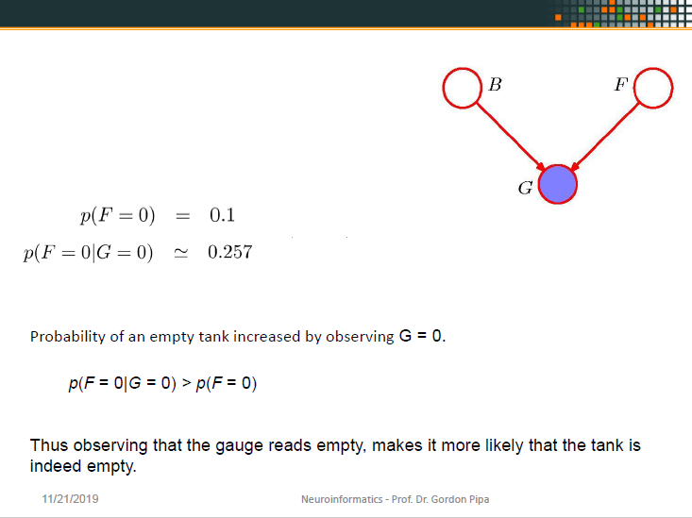
OLD

Slide 16
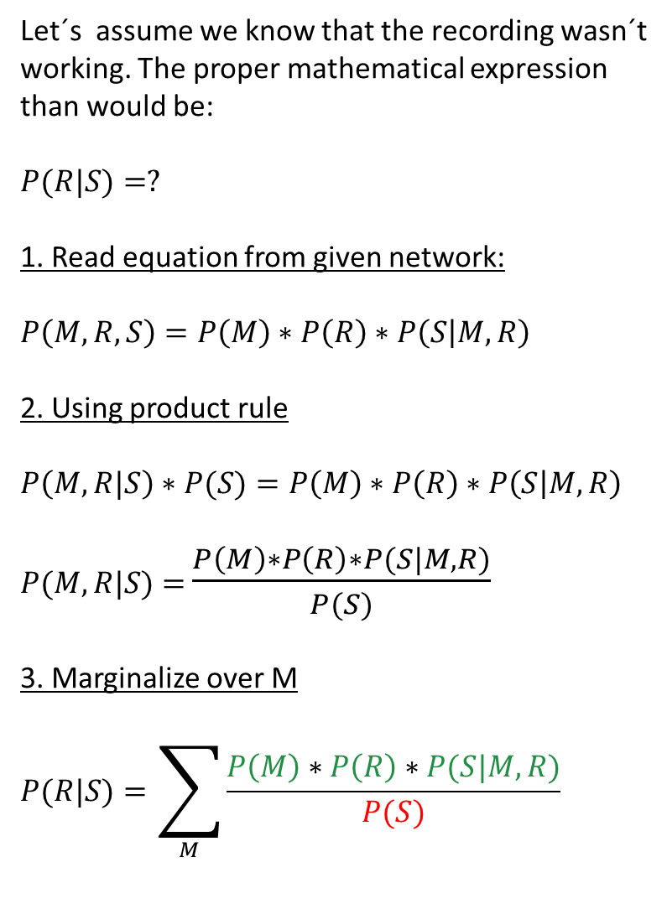
Let´s assume we know that the recording wasn´t working. The proper mathematical expression than would be:
$$P(R|S)=?$$
1. Read equation from given network:
$$P\left(M,R,S\right)=P\left(M\right)∗P\left(R\right)∗P\left(S | M,R\right)$$
2. Using product rule
$$P\left(M,R|S\right)∗P(S)=P\left(M\right)∗P\left(R\right)∗P\left(S | M,R\right)$$
$P(M,R|S)$ $=$ $\frac{P\left(M\right)∗P\left(R\right)∗P(S|M,R)}{P(S)}$
3. Marginalize over M
$$P(R|S)=\sum_{M}{\frac{P\left(M\right)∗P\left(R\right)∗P(S|M,R)}{P(S)}}$$
M
R
=
S
As we see on the tables a slide ago, there is no P(S) that we could directly plug in, as it is not directly given (dependend on p(M) and p(R)).
So we have to calculate it somehow out of the given information.

Slide 17
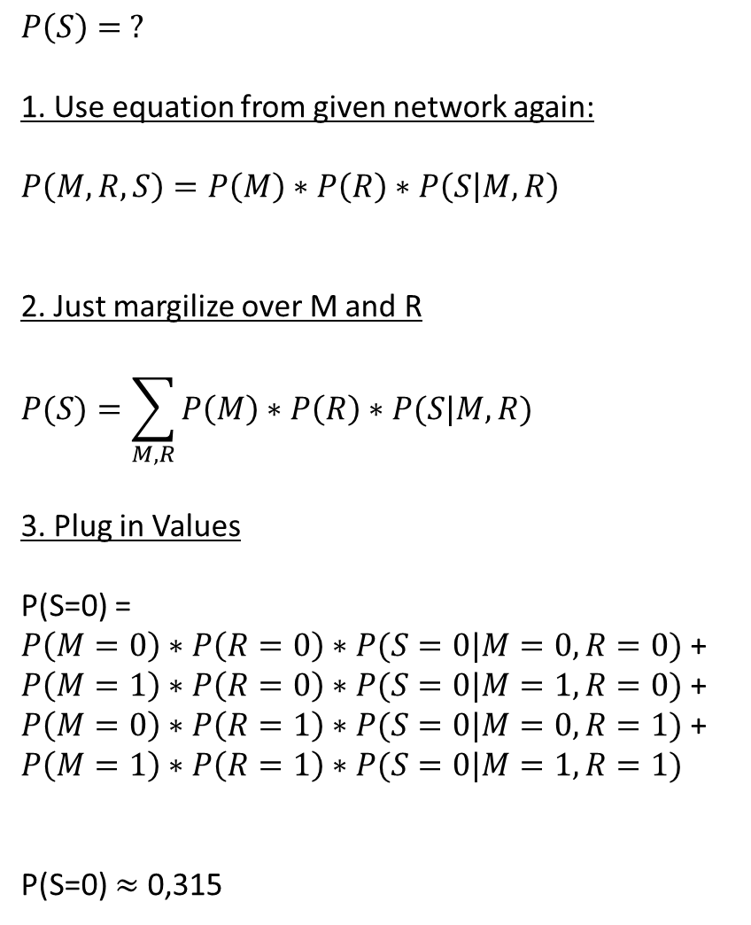
$$P\left(S\right)= ?$$
1. Use equation from given network again:
$$P\left(M,R,S\right)=P\left(M\right)∗P\left(R\right)∗P\left(S | M,R\right)$$
2. Just margilize over M and R
$$P(S)=\sum_{M,R}{P\left(M\right)∗P\left(R\right)∗P(S|M,R)}$$
3. Plug in Values
P(S=0) = $P\left(M=0\right)∗P\left(R=0\right)∗P(S=0|M=0,R=0)$ + $P\left(M=1\right)∗P\left(R=0\right)∗P(S=0|M=1,R=0)$ + $P\left(M=0\right)∗P\left(R=1\right)∗P(S=0|M=0,R=1)$ + $$P\left(M=1\right)∗P\left(R=1\right)∗P(S=0|M=1,R=1)$$
P(S=0) $≈$ 0,315
M
R
=
S
Now that we calculated our P(S=0) we can return to our original task.
As a side note: We just calculated the probability of an unsuccesfull recording without knowing anything about the recording functionality or the state of the microphone given the probabilities on the table ☺

Slide 18
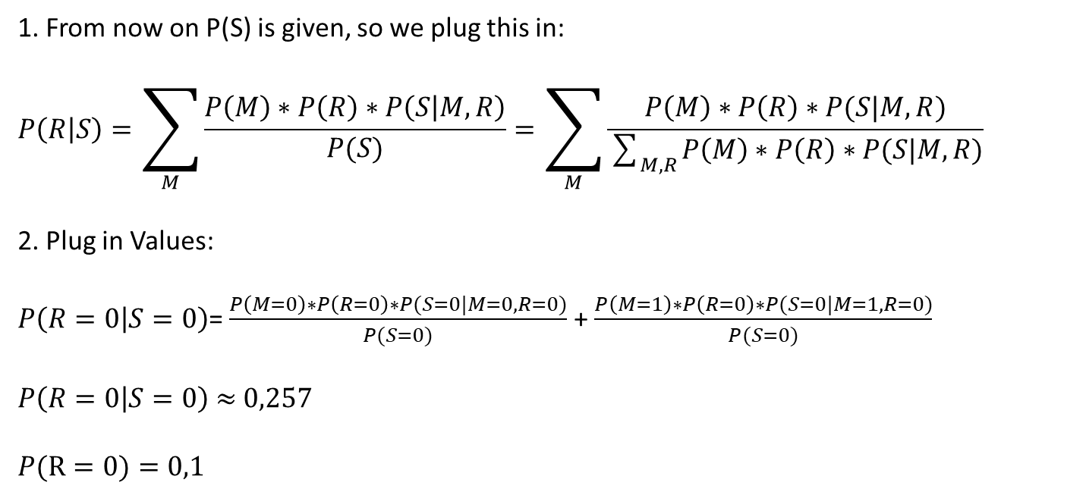
1. From now on P(S) is given, so we plug this in:
$$P\left(R | S\right)=\sum_{M}{\frac{P\left(M\right)∗P\left(R\right)∗P\left(S | M,R\right)}{P(S)}}=\sum_{M}{\frac{P\left(M\right)∗P\left(R\right)∗P(S|M,R)}{\sum_{M,R}{P\left(M\right)∗P\left(R\right)∗P(S|M,R)}}}$$
2. Plug in Values:
$P\left(R=0 | S=0\right)$= $\frac{P\left(M=0\right)∗P\left(R=0\right)∗P(S=0|M=0,R=0)}{P(S=0)}$ +$\frac{P\left(M=1\right)∗P\left(R=0\right)∗P(S=0|M=1,R=0)}{P(S=0)}$
$P\left(R=0 | S=0\right)$ $≈$ $0,257$
$$P(R=0)=0,1$$
Probability of problems with the recording function (B) increased by observing S = 0
p(R = 0|S = 0) > p(R = 0)
Thus knowing that the recording wasn´t successful, makes it more likely that the recording functionality wasn´t working properly. -> Simply common sense displayed in a mathematical manner.

Slide 19
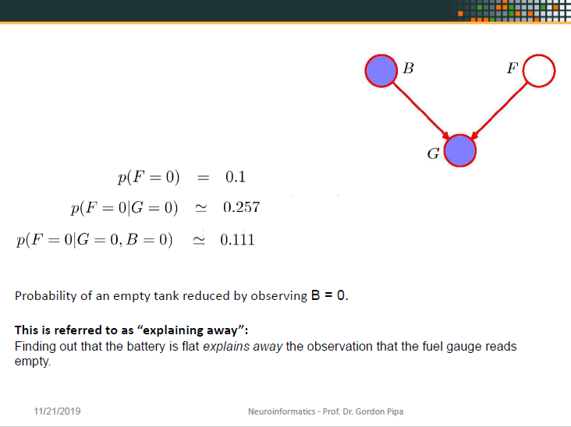
OLD

Slide 20
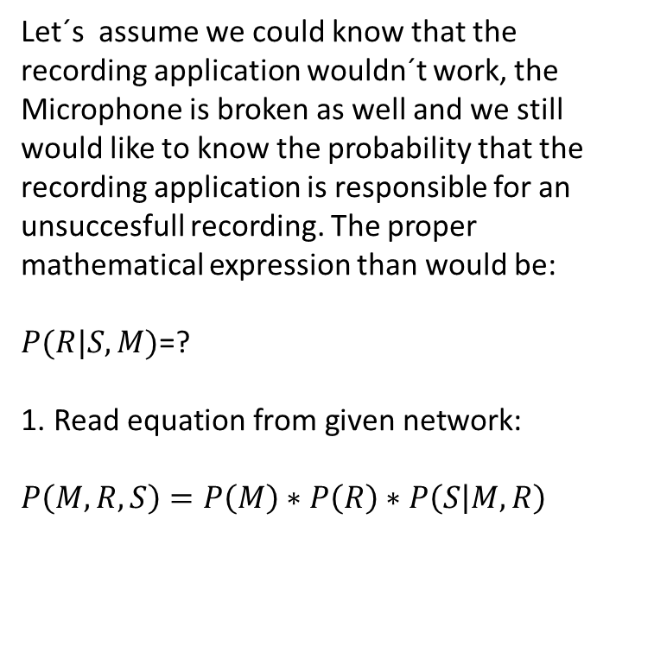
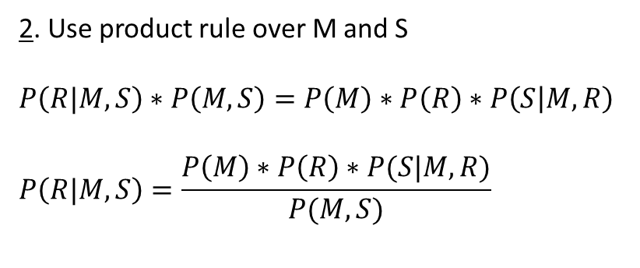
Let´s assume we could know that the recording application wouldn´t work, the Microphone is broken as well and we still would like to know the probability that the recording application is responsible for an unsuccesfull recording. The proper mathematical expression than would be:
$P(R|S,M)$=?
$$\text{1}\text{. }\text{Read} \text{equation} \text{from} \text{given} \text{network}\text{:}$$
$$P\left(M,R,S\right)=P\left(M\right)∗P\left(R\right)∗P\left(S | M,R\right)$$
M
R
S
=
As we see on the tables a slide ago, there is no P(M,S) that we could directly plug in, as it is not directly given (dependend on p(M) and p(R)).
So we have to calculate it somehow out of the given information again ;).
2. Use product rule over M and S
$$P\left(R|M,S\right)∗P\left(M,S\right)=P\left(M\right)∗P\left(R\right)∗P\left(S | M,R\right)$$
$$P\left(R|M,S\right)=\frac{P\left(M\right)∗P\left(R\right)∗P(S|M,R)}{P(M,S)}$$

Slide 21
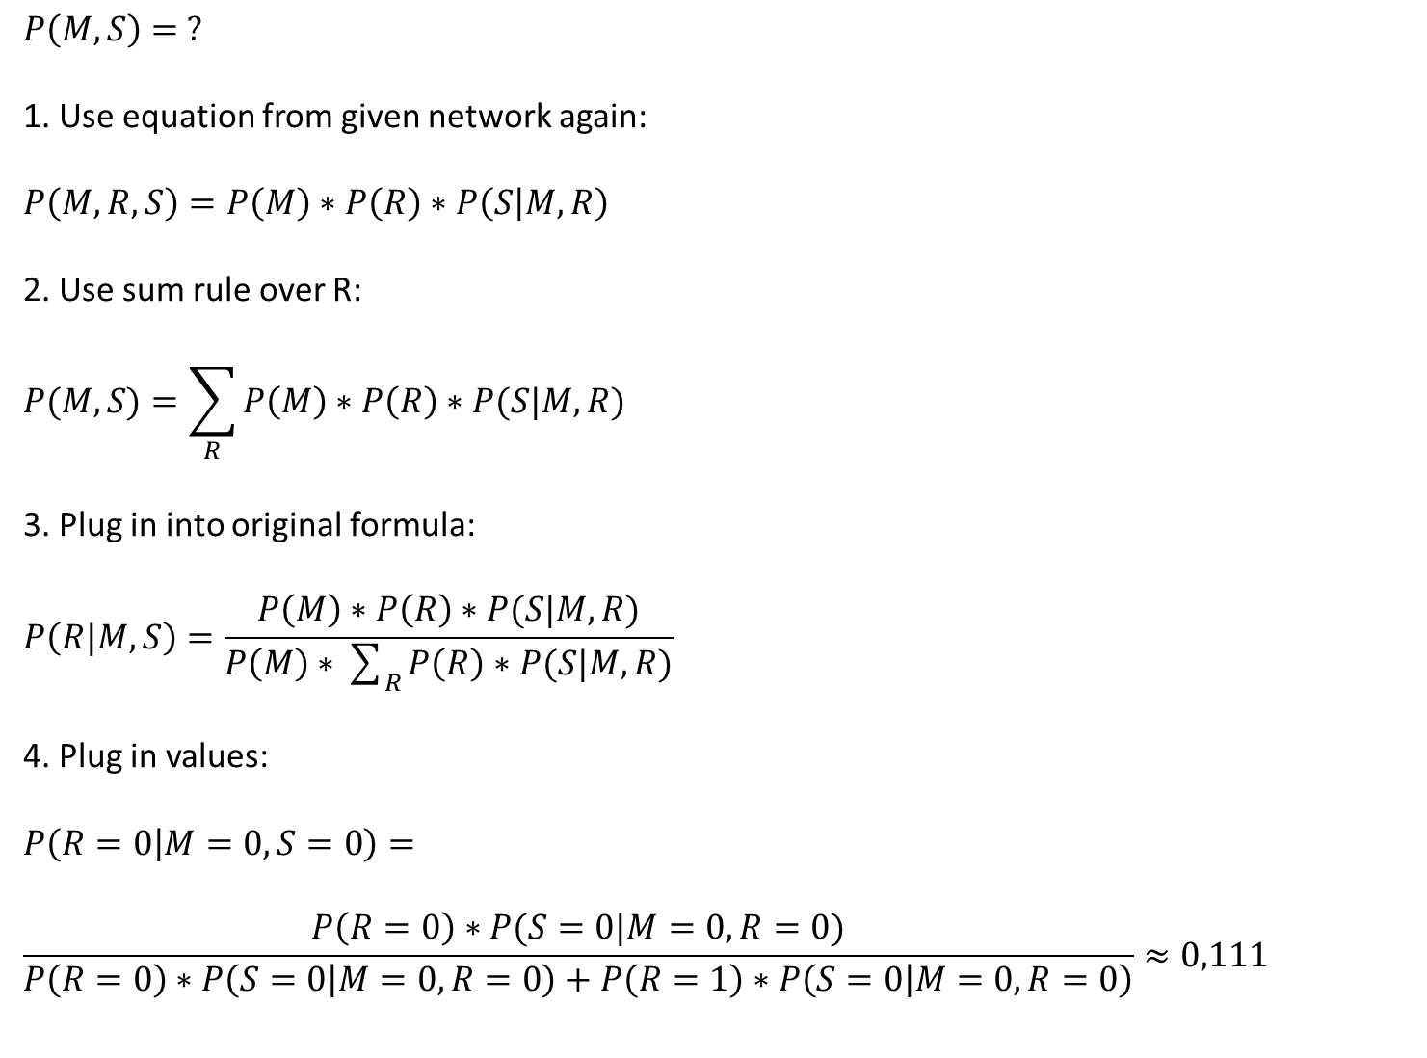
$$P\left(M,S\right)= ?$$
1. Use equation from given network again:
$$P\left(M,R,S\right)=P\left(M\right)∗P\left(R\right)∗P\left(S | M,R\right)$$
2. Use sum rule over R:
$$P(M,S)=\sum_{R}{P\left(M\right)∗P\left(R\right)∗P(S|M,R)}$$
3. Plug in into original formula:
$$P\left(R|M,S\right)=\frac{P\left(M\right)∗P\left(R\right)∗P(S|M,R)}{P\left(M\right)∗\sum_{R}{P\left(R\right)∗P(S|M,R)}}$$
4. Plug in values:
$$P\left(R=0 | M=0,S=0\right)=$$
$$\frac{P\left(R=0\right)∗P(S=0|M=0,R=0)}{P\left(R=0\right)∗P\left(S=0 | M=0,R=0\right)+P\left(R=1\right)∗P\left(S=0 | M=0,R=0\right)}≈0,111$$
M
R
=
S
The Probability of an malfunction in BBB is reduced due to observing the malfunction of the micro.
This is referred to as “explaining away”:
Finding out that the micro actually isn´t working properly explains away that the recording wasn´t successful.

Slide 22


Questionnaire
Q
Start
Timer
Stop
freemusicarchive.org/music/Kai_Engel/

Slide 23
Questionnaire
S

